Slide 1
Shared Memory Consistency Models: A Tutorial
By Sarita V Adve and Kourosh Gharachorloo
Presenter: Sunita Marathe

Slide 2
Overview
What is a Memory Consistency Model ?
Uniprocessor memory consistency
Multiprocessors
Shared memory multiprocessor memory consistency
  Sequential Consistency (SC) model
  Relaxed Models

Slide 3
Memory Consistency Model
A memory model provides a formal specification of the effect of read and write operations on the memory system and describes how memory appears to the programmer
Bridges the gap between the behavior expected by the programmer and the actual behavior of the program.
Memory model affects:
-- Programmability (easy-of-programming)
  -- Performance (optimizations that it allows)
  -- Portability (moving software across different systems)

Slide 4
Uniprocessor memory model
In a non-parallel program, all memory accesses are done via a single-thread of control executing on a single processor
A uniprocessor presents a simple and intuitive view of memory to programmers based on sequential semantics
Memory operations are assumed to execute one at a time in the order specified by the program’s code

Slide 5
Uniprocessor memory model
Memory operations are assumed to execute
one at a time, ie. an operation executes atomically w.r.t other operations
in the order specified by the program’s code
So there is an ordering on the memory operations.
A read is assumed to return the value of the last write to the same location
Last is precisely defined by program order

Slide 6
Uniprocessor memory model
A processor’s speed is orders of magnitude faster than memory access speeds
Compilers and h/w perform various optimizations to hide memory latency
Can result in overlapping, reordering or elimination of memory operations
OK in a single-threaded program as long as program order is preserved between memory operations to the same location, thereby preserving control and data dependences

Slide 7
Uniprocessor Optimizations
Re-ordering optimizations
Compiler optimizations
  Register allocation, code motion etc.
H/W optimizations occuring at various levels
  Processor issues operations out of order
  Use of write buffers causes reordering of W->R to different locations
  Non-blocking caches can cause reordering
Reorderings that preserve control and data dependence are OK, since memory is being viewed only by a single processor/thread

Slide 8
Multiprocessors
Differentiated based on communication mechanism between nodes
Message passing : each processor has own memory. Communication via messages
Shared memory: single address spaces. Communication thru read/write operations to shared memory

Slide 9
Shared Memory Multiprocessors
In a typical scalable shared-memory multiprocessor system
The memory is distributed among the nodes; hence local VS remote memory accesses
Nodes are connected using a general network, the paths thru which take varying amounts of time
Processor environment within a node is similar to that of a uniprocessor, ie. Write buffers, cache etc.

Slide 10
Shared Memory Multiprocessors
Optimizations to hide memory latency assume greater importance in multiprocessors
Memory Latency is greater because:
Operation may involve a remote node
Larger cache miss rate due to communication among processors

Slide 11
Shared Memory Model
Multiple processors concurrently operate on shared memory
All processors need to have a common view of the shared memory
This is complicated by the compiler and hardware optimizations required to efficiently support a single address space. These can cause processors to observe distinct views of shared memory
Need a conceptual model for the semantics of memory operations to allow programmers to use shared memory correctly

Slide 12
Sequential Consistency model
Intuitively, the execution of a multi-threaded program on a multiprocessor should behave the same as the interleaved execution of the threads on a uniprocessor
Consider the multiprocessor as a collection of sequential uniprocessors accessing a common memory. Only a single processor accesses memory at a time
P1
P2
P3
Pn
MEMORY

Slide 13
Sequential Consistency model
Definition:
  [A multiprocessor system is sequentially consistent if] the result of any execution is the same as if the operations of all the processors were executed in some sequential order, and the operations of each individual processor appear in this sequence in the order specified by its program.
Sequential consistency requires appearance of maintenance of
program order among operations from individual processors
a single sequential order among operations from all processors i.e. they ececute one at a time, i.e. an operation executes atomically w.r.t other operations

Slide 14
Sequential Consistency model
Initially: Flag1 = Flag2 = 0
P1 P2
Flag1 = 1 Flag2 = 1
if (Flag2 == 0) if (Flag1 == 0)
critical section critical section
Illustrates importance of maintaining program order among operations from a single processor. Notice that the Read and Write of each processor is to different memory locations.
Sequential consistency is violated if P1 or P2 reorder their Write and Read, allowing both to read a value 0 enter the critical section

Slide 15
Sequential Consistency model
Initially A = B = 0
P1 P2 P3
A = 1
if (A ==1)
B = 1
if (B==1)
reg1 = A
Illustrates importance of atomic execution of memory operations.
Sequantial consistency is violated if
P1’s Write(A) is seen by P2 but not by P3 and
P2’s Write(B) is seen by P3, allowing reg1 to get value 0

Slide 16
Implementing Sequential Consistency
Architecture without caches
Architecture with caches

Slide 17
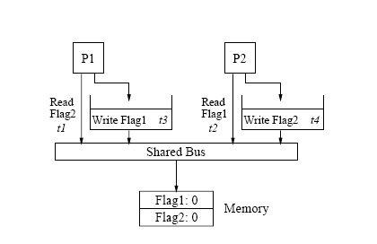
SC architectures without caches
SC violation due to write buffers with bypassing capability
Initially: Flag1 = Flag2 = 0
P1 P2
Flag1 = 1 Flag2 = 1
if (Flag2 == 0) if (Flag1 == 0)
CS CS

Slide 18
SC architectures without caches
SC violation due to write buffers with bypassing capability
Each processor buffers its write and allows subsequent read to different address to bypass the write
So both reads of the flags return the value 0 allowing simultaneous entry into the CS
- Safe on uniprocessor system, since a read address that matches a buffered write will get value from write buffer

Slide 19
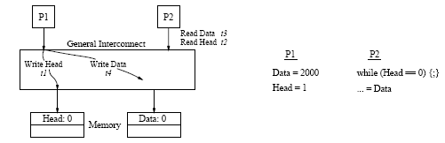
SC architectures without caches
SC violation due to overlapping Write Operations

Slide 20
SC architectures without caches
SC violation due to overlapping Write Operations
A general interconnection network alleviates the serialization bottleneck of a bus-based design
multiple memory modules provide the ability to service multiple operations simultaneously
Problem: write operations issued by the same processor to locations in different memory modules may complete out of order.
P1’s Write (Head) completes before Write (Data)
P2 sees new Head, but old Data
OK on uniproceessor since memory accesses are sequential.
Solution: delay injecting the next Write into the network a until processor receives an ack that its previous write has reached its target

Slide 21
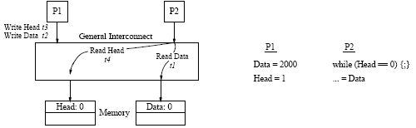
SC architectures without caches
Non-Blocking Read Operations

Slide 22
SC architectures without caches
SC violation due to Non-Blocking Read Operations
If P2 issues its reads in an overlapped fashion, it is possible for
P2’s Read (Data) to arrive at memory before Write (Data) from P1, while
Read (Head) reaches memory after Write(Head) from P1
This leads to a non-sequentially-consistent outcome

Slide 23
SC architectures with caches
The replication of shared data introduces three additional issues
The presence of multiple copies requires a mechanism, referred to as the cache coherence protocol, to propagate a newly written value to all cached copies of the modified location.
Detecting when a write is complete (to preserve program order between a write and its following operations) requires more transactions in the presence of replication.
Propagating changes to multiple copies is inherently a non-atomic operation making it more challenging to preserve the illusion of atomicity for writes with respect to other operations.

Slide 24
SC architectures with caches
Cache coherence model
Basic requirements commonly associated with a cache coherence model are:
a write is eventually made visible to all processors
writes to the same location appear to be seen in the same order by all processors (referred to as serialization of writes to the same location)
Not strong enough for Sequential Consistency which requires
all writes to be serializable and
program order among operations from individual processors

Slide 25
SC architectures with caches
Cache coherence protocol
A cache coherence protocol is the mechanism that propagates a newly written value to the cached copies of the modified location.
Typically achieved by either invalidating the copy or updating the copy to the newly written value.
A memory consistency model places an early and late bound on when a new value can be propagated to any given processor.

Slide 26
SC architectures with caches
Detecting the Completion of Write Operations
Asssume each processor has a write thru cache.
P2 has Data in its cache.
P1 proceeds with Write(Head) after its Write(Data) reaches memory, but before the update/invalidation reaches P2
Possible for P2 to see new value in Head but old cached value for Data

Slide 27
SC architectures with caches
Detecting the Completion of Write Operations (cont..)
Soln: P1 waits for P2’s cached copy of Data to be invalidated or updated.
Target caches ack the reciept of an invalidate/update msg
When acks from all target caches are collected, the processor that did the Write is notified

Slide 28
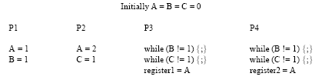
SC architectures with caches
Maintaining atomicity of writes: Condition 1
  Seq consistency is violated if P3 and P4 see the writes to A in a different sequence and hence read different values for A
  Soln:
  Writes to same location must be serialized
  All update/invalidate msgs for a given location originate from a single point and the ordering of these msgs between a given source and destination is preserved by the network

Slide 29
SC architectures with caches
Maintaining atomicity of writes: Condition 2
A and B are cached by all processors
Initially: A = B = 0
P1 P2 P3
A = 1
if (A ==1)
B = 1
if (B==1)
reg1 = A
Sequantial consistency is violated if
Update for P1’s Write(A) reaches P2 but not P3
Update for P2’s Write(B) reaches P3 before update for P1’s Write (A)
P3 returns old value for A from its cache

Slide 30
SC architectures with caches
Maintaining atomicity of writes: Condition 2 (cont …)
Cause of SC violation:
P2 is allowed to read new value of A before update message reaches P3
Solution:
Prohibit a read from returning a newly written value until all cached copies have acknowledged the receipt of the invalidation or update messages generated by the write.

Slide 31
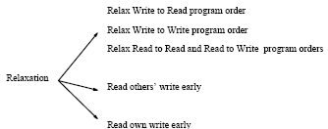
Relaxed Memory models
Allow performance enhancing optimizations
Differentiated and compared based on:
  How do the models relax program order
  How do the models relax write atomicity
Provide mechanisms to override program order relaxations
Relaxations: First 3 deal with Program Order for operations to different locations, last 2 with Atomicity

Slide 32
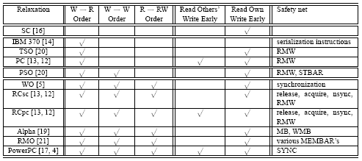
Relaxed Memory models
Different model implementations

Slide 33
Relaxing W → R order
Models: IBM 370, SPARC Total Store Order (TSO) and PC
Differ in how they relax atomicity:
IBM enforces strict atomicity. TSO relaxes for when read is for a buffered write from the same processor. PC enforces nothing
P1 P2 Initially: A = Flag1 = Flag2 = 0
Flag1 = 1 Flag2 = 1
A = 1 A = 2
r1 = A r3 = A
r2 = Flag2 r4 = Flag1
Result:
r1 = 1, r3 = 2, r2 = r4 = 0
This result is possible with TSO and PC, but not with IBM 370

Slide 34
Relaxing W → R order (cont…)
Initially: A = B = 0
P1 P2 P3
A = 1
if (A == 1)
B = 1
if (B == 1)
register1 = A
Result: B = 1, register1 = 0
This result is possible with PC, but not with TSO and IBM 370

Slide 35
Relaxing W → R order (cont…)
Safety Nets:
IBM:
Inserting a serialization instruction (a memory synchronization instr like “compare&swap” or a non-memory instr such as branch) between a W and a R will force them to serialize
TSO and PC:
Replacing the W or R by a read-modify-writes enforces serialization

Slide 36
Relaxing W → W
SPARC Partial Store Model (PSO)
Safety Net:
Insert STBAR instruction in write buffer between WRITESs to different locations
The WRITEs in the buffer that are ahead of the STBAR are completed before attempting the WRITES behind the STBAR

Slide 37
Relaxing all program orders
Example: Weak Ordering
Safety net:
Inserting a synchronization operation between regions of data operations forces the order between the 2 regions to be preserved.
Data operations within a region may be reordered
Issue a sync operation only after all previous data operations have completed.
Issue a data operation only after a previous sync operation is completed.

